Slide 1

Streamlining Power BI with PowerShell
Notes:
This session is aimed towards the Power BI people who just might want to add some functionality with the help of Powershell.
We don’t expect you to be an expert in Powershell but hopefully after this you can see the possibilities and added value that it could bring.

Slide 2


Who are these people?
Linda Torrång
Swedish
Power BI
DataMasterminds
Sander Stad
Dutch
PowerShell
DataMasterminds

Slide 3
What are they going to talk about?
Power BI
PowerShell
Notes:
Who here is on the Power BI side of the fence?
And who is on the Powershell side?
The beautiful marriage of PBI and Powershell.
Power BI is a great tool for reporting and insights. Powershell is great for automating things.
Combining them makes a pretty strong marriage. Especially from an admin point of view.
Much of the work for an Admin in Power BI can be very time-consuming.
MS have built reports for this purpose of getting overviews and they give some of the info that we would need.
But it’s just that you still need to execute on that info.
And MS has also built REST API and Powershell modules to help us with this.
But still it’s not really getting us all the way since it’s on item to item basis.
We wanted to have a way of combining insights and action to make it more streamlined when you need to do many things at once.

Slide 4
Power BI estate assesment
Overview
Set up
Organize
Notes:
Imagine you’re working as a consultant, coming in to a new client and are expected to do a Power BI estate assessment.
First, you would like to have an *overview of what capacities we are dealing with, then how many workspaces are there, number of reports in them, datasources, users and so on.
When I have that first overview with counts on items and know how big of an environment I’m dealing with, I would probably move on to check if things are *set up as they should.
Do all the workspaces have an admin assigned to them, do the datasources have refresh schedules, do we have a licenses that aren’t being utilized and so forth.
How are the general adoption patterns looking.
When I know that I would move on to the *“get organized” stage and clean things up.
-For that to happen I would have to go through a whole lot of things one by one.
This is where we hope to add some value.
Not replacing other things already available but as a value-adding possibility where an Admin could do stuff faster.

Slide 5



Why are they talking about this?
Save time
Save energy
Save cost
Streamline and automating are key to effective work
Notes:
And why?
The job description for an Power BI Admin has extended somewhat during the latest year or so.
There are a lot of things to do and keep track of.
And doing things one by one is very time consuming.
The way of getting around that is doing things in bulk.
Which will save time, energy and cost for everyone involved.,
And especially letting that index finger attached to the admin relax a bit,
who then doesn’t have to do a million clicks to perform even the smallest action.

Slide 6

Power BI Admin report
Notes:
So were do we begin. Well at the place where most Power BI admins feel at home.
We are going to take a look at the premade Power BI Admin report that Microsoft has assembled.
And I just want to mention, they have built one for us for easy use. Which is nice.
And we can always build our own admin reports the way we like them.
That requires work of course, which Admins doesn’t always have time for.
So for the sake of this session we are only looking at what we are dealt with as a prebuilt option.

Slide 7
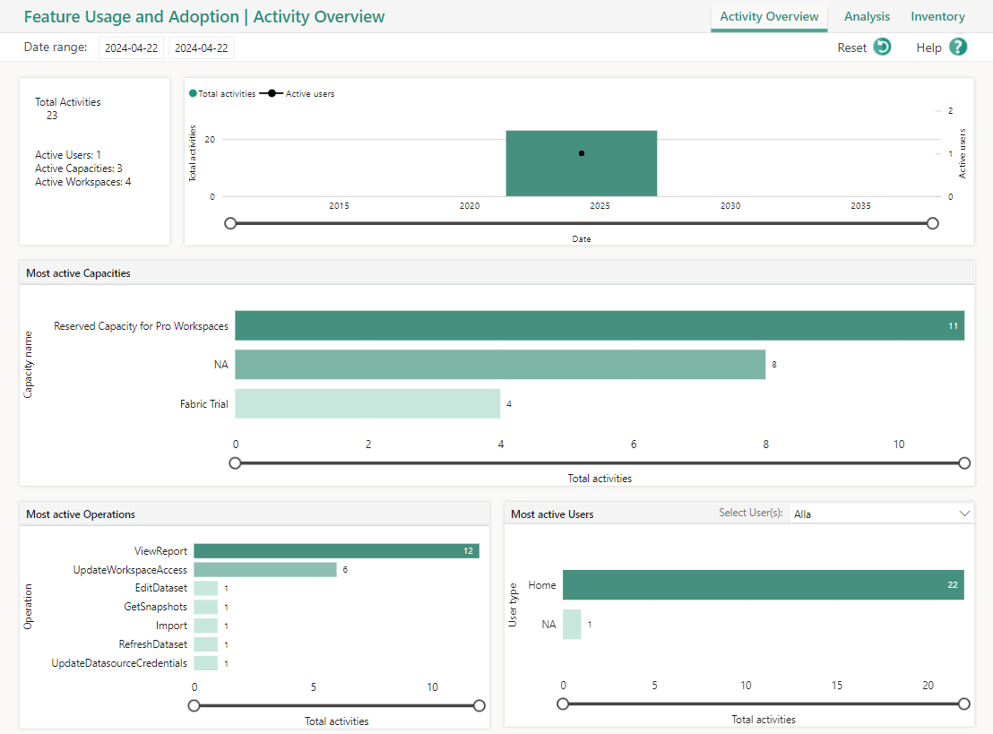
Notes:
Let’s start by looking at the Activity Overview, where we can see the number of activities and the number of activity users.
The only thing that really tells me is A, If things are actually alive in this tenant. And B if there are more than one user doing it.
We can see the most used capacities. But remember, not all tenants have more than one capacity. Which can be a very boring visual in that case.
The most active operations, yeah that is starting to get interesting and of course which users are most active.
I would assume that amongst the users Home means people from our Entra ID. And NA are guest accounts.
Not explained here as far as I can see.
Moving on to the inventory page.

Slide 8
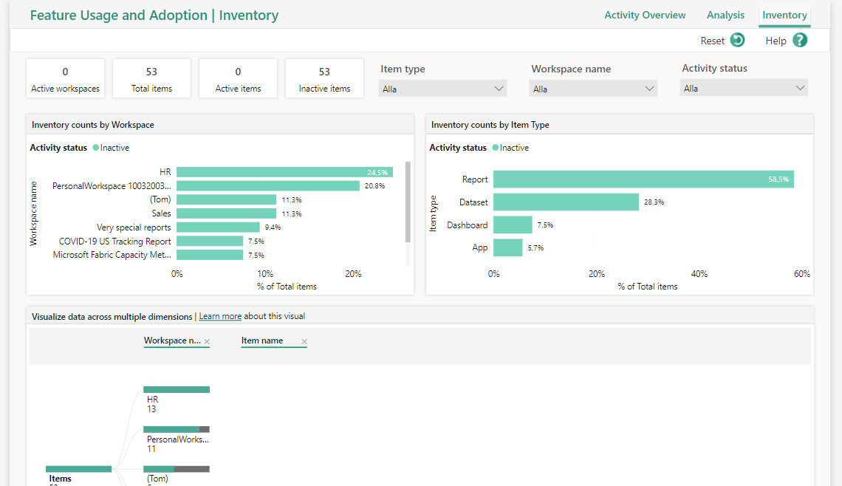
Notes:
I can see some counts of items.
And by items that means Dashboard, Report, Datasets and Apps.
I can filter and see these items depending on the Workspace name.
This page purpose is to get some insight into feature usage and adoption.
Which can be concluded from the Activity status of items.
And yet I cannot see unused Workspaces. And what items belong to those unused workspaces.
In the filter for Activity Status, I can choose inactive Which I have done here.
But that is not really what I’m searching for. What does it mean that a workspace is 24,5% inactive?
Again not really that easy to interpret.

Slide 9
Power BI Admin Report
All insights
- no action
Notes:
This report is meant to be all about the insights. But no possible actions.
I do get some insights into which items are mostly used.
The rest can be a bit confusing to be honest.
But again, as an Admin. That is nice info.
Not necessarily the kind of info that I as an Admin need to act upon. But nice to have.
Instead I would like to have something that would require some action from me, things like a list of unused workspaces, both ordinary and personal ones.
And I would like to know which workspaces are orphaned, that’s the ones that don’t have an Admin attached to them.
Maybe even a list of users that aren’t active at all, are they supposed to be active and I need to address that adoption issue or have they quit and I can revoke those licenses?

Slide 10

Admin portal
Notes:
If we want to get some more actions to our insights we go for the Admin portal.
Where we can do many things, but they also require a lot of clicks with that index finger.

Slide 11
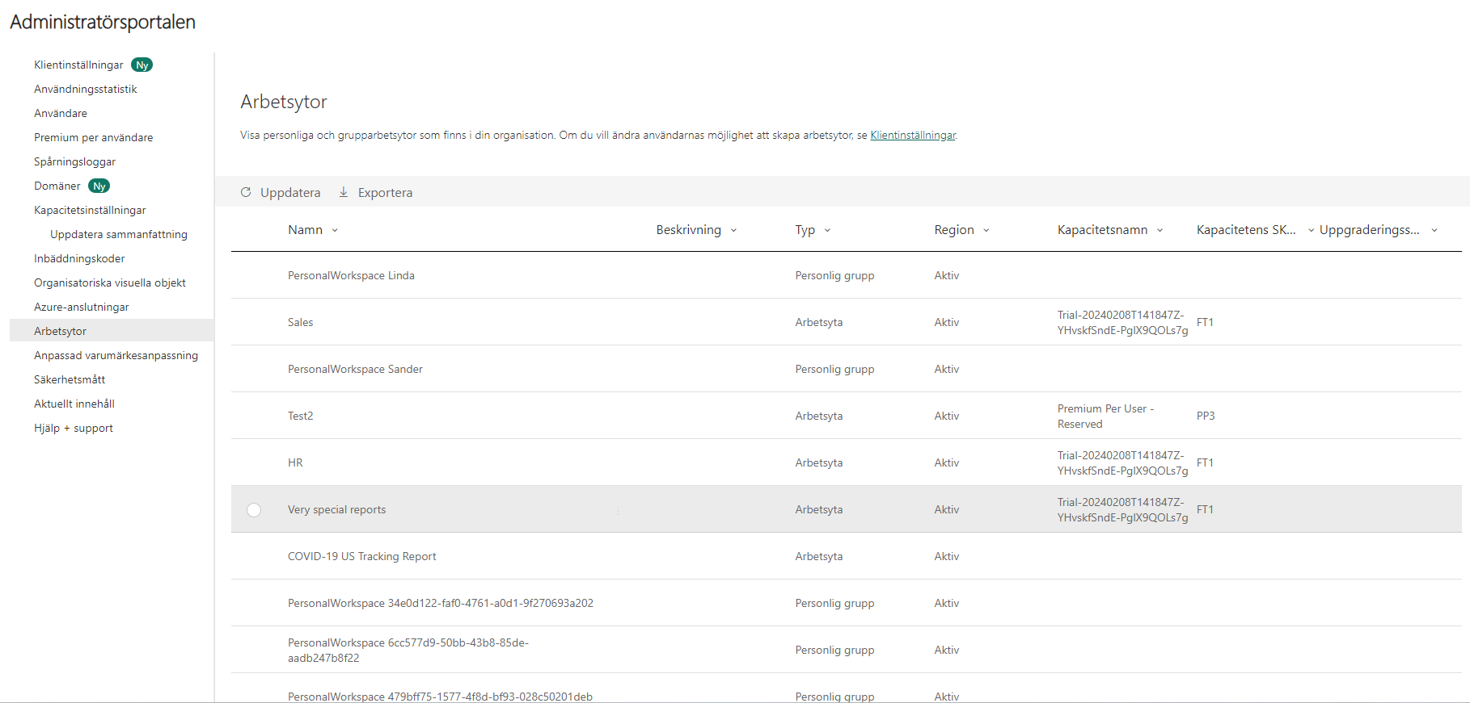
Notes:
Here I can view which workspaces are orphaned. And assign an Admin to them so they are no longer orphaned.
We can go into every workspace and change the names.
Likewise if I want to change the reports name- then I first need to navigate to the workspace, then the report and after that go into settings.
I can change which capacity this workspace is allocated to. But again, going into each and every one of them.
You might remember that Microsoft is deprecating Power BI Premium capacity.
So for a client using that, many workspaces will need to be reallocated.
That would be nice to be able to do in one go.
We can also remove unused workspaces. But again one by one.
And that is not very fun work to do.
Oftentimes there are MANY workspaces and working through them all takes time.
I can see which state the workspace is in. But this is a funny thing, again somewhat confusing.
Active, doesn’t really show the usage which you can assume from the naming Active, just that it is a normal workspace and not a personal one.
Personally I dont like getting confused by insights like this. Takes my energy.

Slide 12
Admin portal
Insights and action
– one item at a time
Notes:
Conclusion: we can do most things here- but it will require a lot of manual work.
But at least we have the possibility for action.

Slide 13

Power BI REST API
Notes:
Power BI Rest Api, This is a well of good functionality for both action and insight.

Slide 14
Power BI REST API
GetGroupAsAdmin
GetGrousUsersAsAdmin
GetAppsAsAdmin
GetAppUsersAsAdmin
GetReportsAsAdmin
GetReportUsersAsAdmin
GetActivityEvents
AssignWorkspacesToCapacity
Notes:
We have a lot of things here like Get Group As Admin, that return A workspace when we give it the Workspace ID.
We can also see the users connected to that specific workspace.
Which is nice and all. Seeing that for a workspace.
But what if I would like to see all of my workspaces with their users?
We can retrieve an App and the users with access to that specific app. Again only one app at a time.
There is a function called AssignWorkspacesToCapacity, where we can change the capacity for that specific workspace.
Like we mentioned earlier- this might soon be a very interesting function for organizations with Premium capacities.

Slide 15
Power BI REST API
Action and Insight
– item-to-item base
Notes:
Basically, I have the same and some more functionality with REST API as I have in the Admin portal. But still not in bulk.

Slide 16
Why are they talking about this?
Save time
Save energy
Save cost
Streamline and automating are key to effective work
Notes:
Again why are we talking about this.
We have stuff like the admin report for insights, we have the portal for action, and we have rest api for both action and insights.
Yes but we want to make it possible to reduce the time and effort an admin has to put in and make their work faster.
Therefore we turned our heads towards Powershell.
And we wanted to do an open source project that many people could benefit from

Slide 17
Why Powershell?
Automate
Take insights to action
Notes:
There are a lot of prebuilt modules and functions from both MS and other people as well.
But as I have such a great colleague who knows this stuff- we can also build our own custom functions to be able to do the things that are still not possible.
Basically, we saw that there was a gap in functionality from an admin perspective, where we would like to build value adding functions to streamline the admins work better. But also make some of the functions that already exist a bit better.
By wrapping some useful REST API into Powershell we can make them work more streamlined.
Getting all of that insights and call to action quicker.

Slide 18
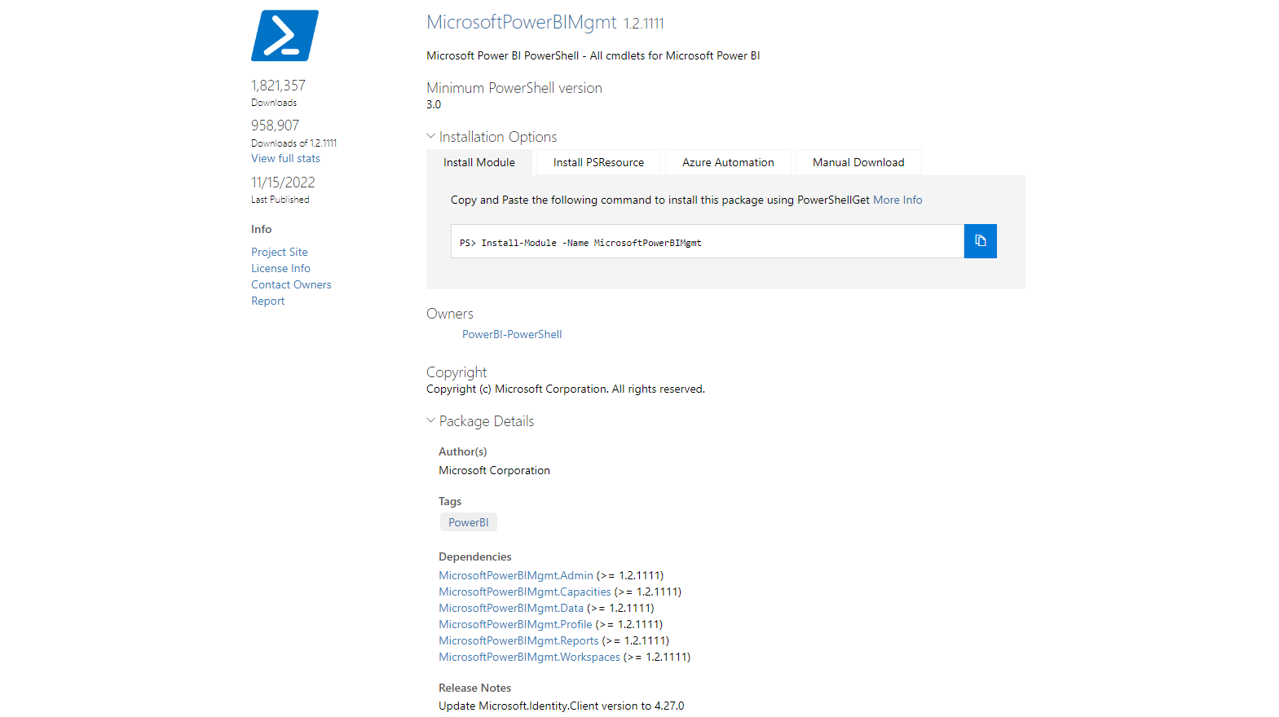
Notes:
Show the MS powershell module.
Talk through things
Explain what is still lacking.
Examples
We have different sections; Admin, Capacities, data and so on.
And in those we have some functions that are interesting.
For example Get Datasets, Get Report, Get Workspaces and such.
We can also get the Activity event which explains what kind of activities the users are up to.
We can see who can access a workspace, and remove or add new users.
No examples
We can not see any kind of lineage to those workspaces, what reports or datasets that are included in those.
We can not se users for Apps for instance.

Slide 19

PSPowerBITools Module
Notes:
Now we are going to demo the new module that we have built.
First of all, we tried to do examples so that if you use this you know more how to work with it.
Our is cleaner, easier to read
More helpful written éxamples
Workspaces, extend with organization scope
A lot of info, hard to get an overview of things
Getting a couple of values, more compressed
What are the properties we should have, cid, dashboards, useful things. leaving out the unhelpful
If there is a property, I should be able to select it.
Workspaces doesn’t show report, something is wrong.
For each ws I can see for example every Admin- loop. Could export to csv.
All in the name of streamlining
You can run into issues with the activity event, it is very specific. Showing that.
Namechange workspace
If I would like to go change every name of the reports in a workspace, to prefix with Dev/Test or something. Could i do that?
Orphaned ws, set an admin for them all
Change the capacity id for all workspaces
List all unactive users and revoke licenses

Slide 20

Then what?
Notes:
As we said earlier, we have tried adding value to already existing functions, to make them more accessible and readable.
As well as building out new functions where we could do things in a faster more automated fashion instead of doing a million clicks.
Actions you can take for clean-up in bulk
Remove unused reports
Remove unused (personal) workspaces
Remove unused data sources
Remove unused licenses

Slide 21
Streamline admin tasks
Lineage
Access
Refreshes
Ownership
Reassign CapacityId
Backups
Notes:
As we said earlier, we have tried adding value to already existing functions, to make them more accessible and readable.
As well as building out new functions where we could do things in a faster more automated fashion instead of doing a million clicks.
We are just in the beginning of creating possible functions that could be of great value for an admin.
If you have any whishes or request for additions, please let us know and we will try to build it.

Slide 22
Thank you! Please give feedback

